Slide 1


Housing Trends in Metro Atlanta
Presented by
Group 6 (Carnotaurus)
Bradley Barker
Yingying Li
Notes:
Bradley
Hello everyone. We are from Group 6: kaar·nuh·taw·ruhs. Today my partner Yingying and I will be discussing Housing Trends in Metro Atlanta.
Dinosaur pronunciation: kaar·nuh·taw·ruhs
~OR~
Welcome everyone to the Metro Atlanta Single Family Home Real Estate Investors Group. It’s great to see all of you. Today my partner Yingying and I will be discussing Housing Trends in Metro Atlanta.

Slide 2
Agenda
Background
Approach
Analysis
Conclusion
Way Forward
Questions
Notes:
Bradley
For today’s agenda, we will begin with a little background on Metro Atlanta Housing and introduce you to our research questions. Then we will walk you through our calculated approach. Next, we’ll explore our findings and data analysis, followed by our conclusions and what the future may hold for further research. Feel free to interrupt us if you need any clarification. Otherwise, we’ll have a Q&A session at the end. Now I’ll pass it over to Yingying with some background on the topic.

Slide 3
Background
Goal: We are trying to help local metro-Atlanta real estate investors understand housing market trends and find areas that are more affordable.
Research Question 1: Is housing becoming less affordable?
Hypothesis1 (H₁): From 2013 to 2019, housing has become less affordable.
Research Question 2: Does the housing affordability trend have the same effect on the areas with different income levels?
Hypothesis2 (H₂): The difference in affordability is increasing over the years between areas with lower household income and areas with higher household income.
Notes:
Yingying
Thank you Bradley. So Bradley and I are both interested in the real estate market, especially after seeing how crazy the housing market has been during COVID. We decided to act as a research team to help local metro-Atlanta real estate investors understand the housing market trends and find areas that are more affordable.
The first question we are trying to answer is whether housing has become less affordable. Our hypothesis is that from 2013 to 2019, housing has become less affordable. We had to use census data for part of our analyses and Census Bureau data is updated up to year 2019, hence why we wrote our hypothesis this way.
If you have ever worked with a real estate agent or mortgage loan offer, one of the first things they would ask is “what’s your budget”. In our exploratory data analysis, we found families in zip codes with higher house value also have higher income. With that in mind, it leads to our second research question, where we want to see does the housing affordability trend have the same effect on the areas with different income levels. In other words, does it affect the richer and the poorer the same.
I will turn to Bradley to explain how we tackled these questions.

Slide 4
Approach
Identify variables
Collect Data
Clean Data
Run Analyses
Household Income
Home Value
Affordability Index*
Census Bureau
Zillow
Metro Atlanta area only
Filter by ZIP code
Remove NaN & invalid values
See Analysis slides
Note*.
Affordability Index = Median Single Family Home Value / Median Household Income
In layman’s terms, how many years of median household income would it take to buy a median priced SF house.
Notes:
Bradley
With our goal in place and research questions defined, next we identified our variables, which were Household Income, Home Value, and Affordability Index, which we defined as Median Single Family Home Value / Median Household Income. In layman’s terms, how many years of median household income would it take to buy a median priced SF house. Next, we collected our data. The Household Income was collected from the US Census Bureau API and Home Value from Zillow’s database. We then cleaned our data by filtering to the Metro Atlanta area, then removed NaN (not a number) values and other invalid data such as negative household income. After the data was cleaned up a bit, we were able to perform our analysis.
I will turn it back over to Yingying to go over our first hypothesis.
Appendix
1. Household income, as defined by the gross cash income of all people ages 15 years or older occupying the same housing unit
2. House Price. We used Zillow’s “Zillow Home Value Index” (ZHVI), which they define as a “typical” home value for a region (home values in the 35th to 65th percentile range)

Slide 5
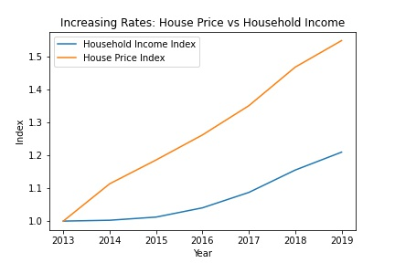
ANALYSIS-Hypothesis1 From 2013 to 2019, housing has become less affordable.
Line chart of house price and household income increasing rates.
House Price Index = Average house price of the year / Average house price of year 2013
Household Income Index = Average household income of the year / Average household income of year 2013
Notes:
Yingying
Thanks Bradley. As a remainder, our first research question is "Is housing becoming less affordable?".
To tackle that, we developed this line chart which looks at the house price and household income increasing rates together. The increasing rates or the indexes are defined as using the value of the year divided by the respective value of year 2013. 2014 House Price Index, for example, is calculated by using 2014’s house price divided by 2013’s house price.
As you can see in the chart, both income and house price were increasing, however, the house price, which is the orange line was increasing at a much faster rate, so it supports our hypothesis.

Slide 6
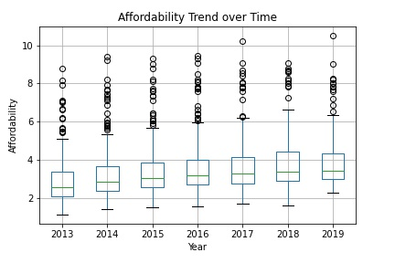
ANALYSIS-Hypothesis1 From 2013 to 2019, housing has become less affordable.
Boxplot of affordability index across all ZIP codes over the years.
Notes:
Yingying
To make it more straightforward, we also added the affordability index and built this boxplot to show how affordability index is distributed over the year. Indicated by the green median lines within the boxes, the median affordability index was increasing between 2013 and 2019. Again, affordability index is calculated using house value divided by household income, the higher the index value is, the less affordable housing is.
As you can see, we have a lot of outliers in the higher affordability index group, so we decided to average the affordability index across all zip codes to see whether the same trend still holds.

Slide 7
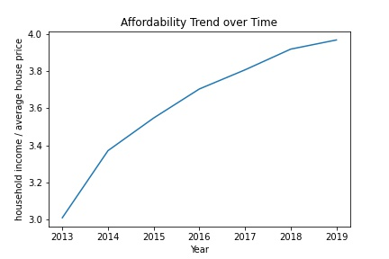
ANALYSIS-Hypothesis1 From 2013 to 2019, housing has become less affordable.
Line chart of affordability index mean across all ZIP codes over the years.
Notes:
Yingying
Here is the line chart we got with average affordability indexes across all zip codes in metro-Atlanta area over the year. And you can find the same upward trend.

Slide 8
ANALYSIS-Hypothesis1 From 2013 to 2019, housing has become less affordable.
Any correlation between Affordability and Year?
r = 0.960871
One-Way ANOVA Tests: are the differences in affordability statistically significant?
2013 vs 2014 | 2014 vs 2015 | 2015 vs 2016 | 2016 vs 2017 | 2017 vs 2018 | 2018 vs 2019 | 2013 vs 2019
p = 0.025* | p = 0.31 | p = 0.40 | p = 0.53 | p = 0.52 | p = 0.77 | p = 5.6e-09*
* Significant differences
Notes:
Yingying
To backup our hypothesis even more, we also did some statistical analysis.
We run the correlation between affordability and year numbers and found a 0.96 correlation between affordability and year. According to Cohen (1988), correlation that is larger than .50 can be considered as having a strong relationship between two variables, which in our case, means there is a strong correlation between affordability and year numbers.
We could run linear regression test as well, but since we only have the average affordability index for 7 years, which means 7 data points. We would run into issues with small sample size. One main issue with small sample size in running any statistical analysis is that the results' reliability is questionable and unlikely to be generalizable to the larger population.
Therefore, we decided to run One-Way ANOVA tests to see whether the differences in affordability across all zip codes between any two years are significant. Surprisingly, we only found significant difference comparing 2013 and 2014, also 2013 versus 2019. We have our own interpretation of why this happened, which we will cover in a next slide.

Slide 9


CONCLUSION-Hypothesis1 From 2013 to 2019, housing has become less affordable.
Housing in the metro-Atlanta area has become less affordable over the years, but it’s not that noticeable if we look at it year by year.
However, the cumulative effect is significant. A house used to only cost 3-year household income in 2013 would cost 4-year household income in 2019.
Notes:
Yingying
So in conclusions, our findings support our hypothesis.
That housing in metro-Atlanta area has become less affordable over the years, but it’s not that noticeable if we look at it year by year.
However, the cumulative effect is significant, suggested by the small p-value when we did one-way ANOVA test between 2013 and 2019 affordability indexes across all zip codes. A house used to only cost 3-year household income in 2013 would cost 4-year household income in 2019.
We like to think this phenomena as the Boiling frog tale, you wouldn’t notice the small changes, but with time, the small changes can form into a drastic one.
I hope I had explained our first analysis clearly. Please let us know if you have any question, otherwise, I am going to turn to Bradley to talk about how we tackle our second hypothesis.

Slide 10
ANALYSIS-Hypothesis2 The difference in affordability is increasing over the years between areas with lower household income and areas with higher household income.
Define Higher and Lower Household Income ZIP codes
Higher Income: If the household income in a ZIP code is greater than or equal to median household income across all ZIP codes.
Lower Income: If the household income in a ZIP code is less than median household income across all ZIP codes.
Higher Income
Lower Income
Notes:
Bradley
Thank you Yingying. With our first hypothesis confirmed, let’s dig into our second one. As a reminder, it was “The difference in affordability is increasing over the years between areas with lower household income and areas with higher household income.” In order to begin this analysis, we first defined Higher Income and Lower income, using the median income as the defining factor between the two.
So a ZIP code was considered Higher Income If the household income in a ZIP code was greater than or equal to median household income across all ZIP codes.
And a ZIP code was considered Lower Income If the household income in a ZIP code was less than median household income across all ZIP codes.
To help you better visualize these income levels and their dispersion across ZIP codes, we created a box plot using 2013 income. The green line within the box represents the median household income. Anything above or equal to that value is considered Higher Income and anything below than value is Lower Income.

Slide 11
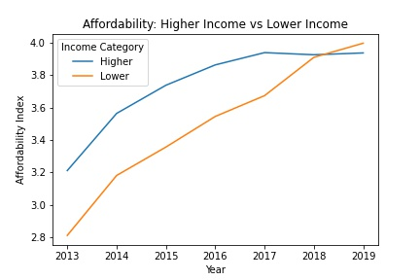
ANALYSIS-Hypothesis2 The difference in affordability is increasing over the years between areas with lower household income and areas with higher household income.
Line chart of affordability indexes for higher and lower household income over the years.
Notes:
Bradley
After we defined Higher and Lower Income ZIP codes, we compared their relationship to the Affordability index. In the line chart, we can see that relationship for the years 2013 through 2019, for both Income Categories. For most of that time frame, the relationship each income category had with the Affordability Index was very similar, in that housing was becoming less and less affordable each year. However, in the span of 2017 to 2019, we can see housing affordability level become more stable for Higher Income ZIP codes, as housing continued to become less affordable each year for Lower Income ZIP codes.

Slide 12
CONCLUSION-Hypothesis2 The difference in affordability is increasing over the years between areas with lower household income and areas with higher household income.
Housing has become less affordable for both higher and lower income families.
Lower Income families are more affected by the housing price increase as housing affordability decreased at a greater rate for them.
Notes:
Bradley
Through our data analysis, we concluded that our findings support our 2nd Hypothesis as well! Housing has become less affordable for both higher and lower income families over the course of 2013 to 2019…However, lower Income families are more affected by the housing price increase as housing affordability decreased at a greater rate for them. Although we may need a few more years of data to trickle in in order to further support this conclusion, the gap has certainly been increasing between the two income levels in recent years.

Slide 13
WAY FORWARD
Limitations & Considerations
Single Family Housing only
Census data is available only up to 2019
Business Implications
Now is the time to invest, since housing is getting less and less affordable.
If you want to invest in a Lower Income ZIP code, invest now. If you want to invest in a Higher Income ZIP code, you can likely wait since the market has stabilized already.
Next steps
Update results with 2020 and 2021 census data
Apply the same research methodology to other metro areas
Take into consideration of other variables (e.g., population density, migration, business development)
Notes:
Bradley (Limitations & Considerations, Business Implications)
When conducting our research, we had to keep in mind our Limitations and other Considerations. For example, we limited our research to only Single-Family Homes. We did this in order to avoid skewing property values by including multifamily, duplexes, mobile homes, and other property types outside our scope. However, we realize this is a limitation in our research as it doesn’t fully encompass Metro Atlanta property values at large. Also, due to the data release schedule of the Census Bureau, we were only able to obtain demographic data up to the year 2019.
As far as Business Implications, we have a few recommendations based on our research. Now is the time to invest, since housing is getting less and less affordable. Also, If you want to invest in a Lower Income ZIP code, invest now. If you want to invest in a Higher Income ZIP code, you can likely wait since the market has stabilized already.
Yingying (Next Steps)
As Bradley mentioned, to expand our current research,
- We will monitor census and update our results when we have 2020 data.
- We can also apply the same methodology to other metro areas.
- We can also take into consideration of other variables, such as population density, migration, or business development in the area

Slide 14


Questions?
Notes:
Yingying
Thank you everyone for listening. Now it’s the time for us to answer any of your questions. Feel free to unmute and ask us anything about our research and analyses.
Bradley - Briefly mention about the appendix after all questions (what’s in appendix)

Slide 15
Appendix
RESOURCES

Slide 16
Resources
Census Library
https://data.census.gov/cedsci/
Database of the US Federal Statistical System who is responsible for collecting and cataloguing data about the American people and the economy at large
Zillow
https://www.zillow.com/research/data/
Zillow is an American online real estate company who utilizes real housing market data to benefit both buyers and sellers alike
Metro Atlanta ZIP code List
https://namecensus.com/igapo/zip_codes/metropolitan-areas/metro-alpha/Atlanta%20(GA)1.html
Atlanta's Beautiful Skyline - At Night - 4K Drone Aerials by Dee Trott
https://www.youtube.com/watch?v=3TOJfg1teLA
GitHub Repository
https://github.com/Yingying-Li-Data/Project_1.git

